Slide 1



Software Engineering Unit-1
Part 1 Software Process
These slides are designed to accompany Software Engineering: A Practitioner’s Approach, 7/e (McGraw-Hill
2009). Slides copyright 2009 by Roger Pressman.
Slides copyright © 1996, 2001, 2005, 2009 by Roger S. Pressman

Slide 2
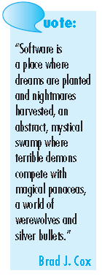
What is Software?
Software is:
(1) instructions (computer programs) that when executed provide desired features, function, and performance;
(2) data structures programs to
that enable the
adequately manipulate
information and
(3) documentation that describes the operation and use of the programs.

Slide 3
Questions about Software?
Why does it take so long to get software finished?
Why are development costs so high?
Why can’t we find all errors before we give the software to our customers?
Why do we spend so much time and effort maintaining existing programs?
Why do we continue to have difficulty in measuring progress as software is being developed and maintained?

Slide 4
Does Software has expiration?

Slide 5
Does Software wear out?
Software is developed or engineered, it is not manufactured in the classical sense.
Software doesn't "wear out."
Although the industry is moving toward component-based construction, most software continues to be custom-built.

Slide 6
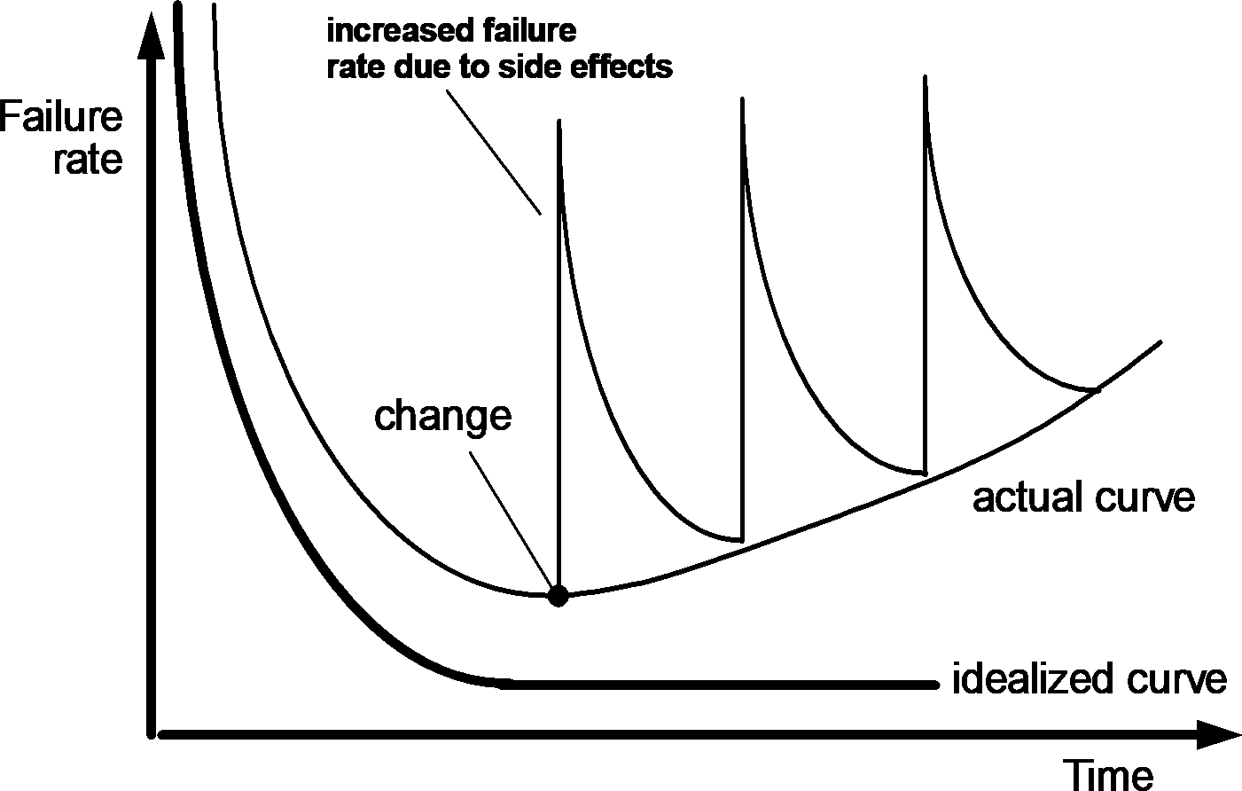
Wear vs. Deterioration

Slide 7
Software Applications
System software
Application software
Engineering/scientific software
Embedded software
Product-line software
WebApps (Web applications)
AI software

Slide 8
Software Applications
System software
System software— a collection of programs written to service other programs.
e.g., compilers, editors, and file management utilities. (Determinate)
operating system components, drivers, networking software, telecommunications processors (Indeterminate)

Slide 9
Software Applications
Application software —stand-alone programs that
solve a specific business need.
Engineering/scientific software —a broad array of “number-crunching programs
Astronomy
Automotive
Orbital dynamics,
Computer-aided design
Molecular biology
Genetic analysis
Meteorology.

Slide 10
Software Applications
Embedded software— resides within a product or system and is used to implement and control features and functions for the end user and for the system itself.
Limited and esoteric functions
Provide significant function and control capability
e.g., digital functions in an automobile such as fuel control, dashboard displays, and braking systems

Slide 11
Software Applications
Product-line software —designed to provide a specific capability for use by many different customers.
Address mass consumer
e.g., inventory control products
Web/Mobile applications
Artificial intelligence software
Applications within this area include robotics, expert systems, pattern recognition (image and voice), artificial neural networks, theorem proving, and game playing.

Slide 12
Legacy Software
These older programs—often referred to as legacy software —have been the focus of continuous attention and concern since the 1960s.
Legacy software systems . . . were developed decades ago and have been continually modified to meet changes in business requirements and computing platforms. The proliferation of such systems is causing headaches for large organizations who find them costly to maintain and risky to evolve.
Dayani-Fard

Slide 13
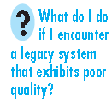
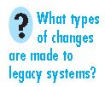
Legacy Software
The software must be adapted to meet the needs of
new computing environments or technology.
The software must be enhanced to implement new business requirements.
The software must be extended to make it interoperable with other more modern systems or databases.
The software must be re-architected to make it viable
within a evolving computing environment.

Slide 14
THE CHANGING NATURE OF SOFTWARE
WebApps
Mobile Applications
Cloud Computing

Slide 15
Provide examples (both positive and negative) that indicate the impact of software on our society

Slide 16
Software Engineering
The IEEE definition:
Software Engineering:
(1) The disciplined,
application
quantifiable approach to the
of a systematic,
development, operation, and maintenance of software; that is, the application of engineering to software.
(2) The study of approaches as in (1).

Slide 17
How do you want to develop a Software? Where do you generally start?

Slide 18
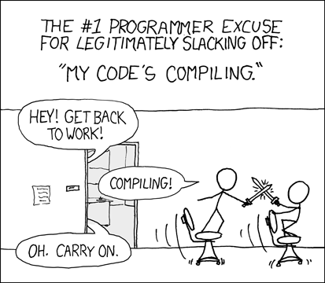

Slide 19

A Layered Technology
Any engineering approach (including software engineering) must rest on an organizational commitment to quality.

Slide 20
A Layered Technology
The software engineering process is the glue that holds the technology layers together and enables rational and timely development of computer software.
Process defines a framework that must be established for effective delivery of software engineering technology.

Slide 21
A Layered Technology
Software engineering methods provide the technical how-to’s
for building software.
Methods encompass a broad array of tasks that include communication, requirements analysis, design modeling, program construction, testing, and support.

Slide 22
A Layered Technology
Software engineering tools provide automated or semi-automated support for the process and the methods.

Slide 23

THE SOFTWARE PROCESS
A process is a collection of activities, actions, and tasks that are performed when some work product is to be created.
An activity strives to achieve a broad objective (e.g., communication with stakeholders).
An action (e.g., architectural design) encompasses a set of tasks that produce a major work product (e.g., an architectural model).
A task focuses on a small, but well-defined objective (e.g., conducting a unit test) that produces a tangible outcome.

Slide 24
The Process Framework
A process framework establishes the foundation by identifying a small number of framework activities that are applicable to all software projects.
The process framework encompasses a set of umbrella activities that are applicable across the entire software process.

Slide 25
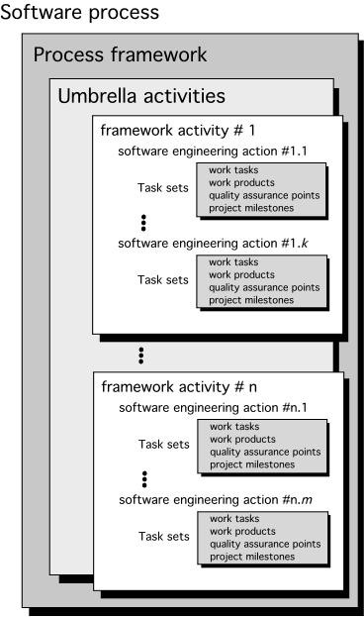
The Process Framework

Slide 26
The Process Framework
A generic process framework for software engineering encompasses five activities.
Communication.
Communicate and collaborate with the customer
(and other stakeholders).
The intent is to understand stakeholders’ objectives for the project and to gather requirements that help define software features and functions.

Slide 27
The Process Framework
A generic process framework for software engineering encompasses five activities.
Planning.
Defines the software engineering work by describing the technical tasks to be conducted.
Risks that are likely, the resources that will be required, the work products to be produced, and a work schedule

Slide 28
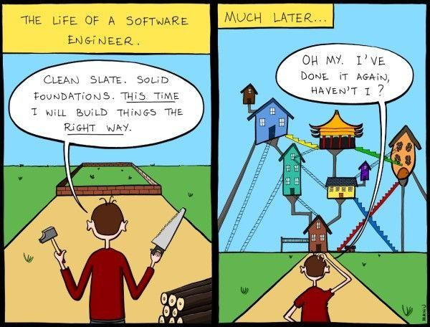

Slide 29
The Process Framework
A generic process framework for software engineering encompasses five activities.
Modeling.
Better understand software requirements and the design that will achieve those requirements.
Waterfall
V-model
Prototype
Agile

Slide 30
The Process Framework
A generic process framework for software engineering encompasses five activities.
Construction.
Code generation (either manual or automated) and the testing that is required to uncover errors in the code.

Slide 31
The Process Framework
A generic process framework for software engineering encompasses five activities.
Deployment.
The software (as a complete entity or as a partially completed increment) is delivered to the customer who evaluates the delivered product and provides feedback based on the evaluation.

Slide 32
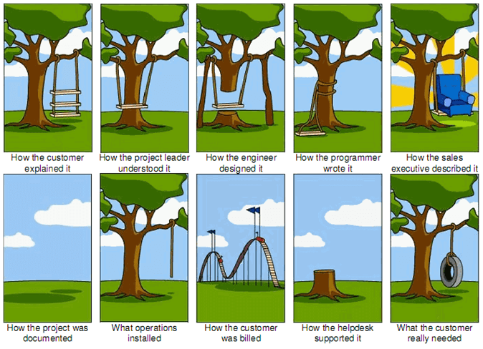

Slide 33
Umbrella Activities
Software project tracking and control
allows the software team to assess progress against the project plan and take any necessary action to maintain the schedule.
Risk management
assesses risks that may affect the outcome of the project or the quality of the product.
Software quality assurance
Defines and conducts the activities required to ensure software quality.

Slide 34
Umbrella Activities
Technical reviews
assess software engineering work products in an effort to uncover and remove errors before they are propagated to the next activity.
Measurement
Defines and collects process, project, and product measures that assist the team in delivering software that meets stakeholders’ needs.
Software configuration management
Manages the effects of change throughout the software process.
Reusability management
Defines criteria for work product reuse (including software components) and establishes mechanisms to achieve reusable components.
Work product preparation and production
encompass the activities required to create work products such as models, documents, logs, forms, and lists.

Slide 35
Process Adaptation
A process adopted for one project might be significantly different than a process adopted for another project.
Differences are
Overall flow of activities, actions, and tasks and the interdependencies among them.
Degree to which actions and tasks are defined within each framework
activity.
Degree to which work products are identified and required.
Manner in which quality assurance activities are applied.
Manner in which project tracking and control activities are applied.
Overall degree of detail and rigor with which the process is described.
Degree to which the customer and other stakeholders are involved with the project.
Level of autonomy given to the software team.
Degree to which team organization and roles are prescribed.

Slide 36
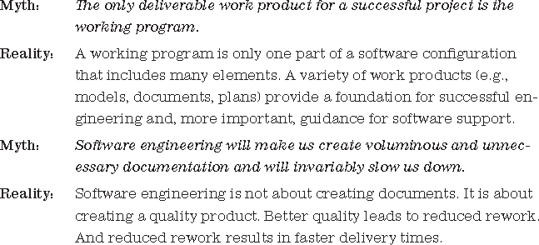
Process Adaptation

Slide 37
Summary
Software engineering encompasses process, methods, and tools that enable complex computer- based systems to be built in a timely manner with quality.
The software process incorporates five framework activities—communication, planning, modeling, construction, and deployment—that are applicable to all software projects.
Software engineering practice is a problem-solving activity that follows a set of core principles.

Slide 38
Recap
What is Software Engineering?
What is a Software Process?
What are the activities in a Software Process?
What are the umbrella activities in a Software Process?

Slide 39


Part -2 Process Models

Slide 40
Process model
A process model provides a specific roadmap for software engineering work.
It defines the flow
of all activities, the degree of
actions and tasks,
iteration, the work products, and the organization of the work that must be done.

Slide 41
Prescriptive Models
A prescriptive process model strives for structure and
order in software development.
That leads to a few questions …
If prescriptive process models strive for structure and order, are they inappropriate for a software world that thrives on change?
Yet, if we reject traditional process models (and the order they imply) and replace them with something less structured, do we make it impossible to achieve coordination and coherence in software work?

Slide 42
The Waterfall Model
Com m unic a t ion
proje c t init ia t ion
Planning
e stima ting sche duling track ing
re quire m e nt ga t he ring
Mode ling
analysis design
Const r uc t io
code t est
n
De ploy m e nt
de liv e ry s upport
f e e dba c k
Classic life cycle
Systematic, sequential approach

Slide 43
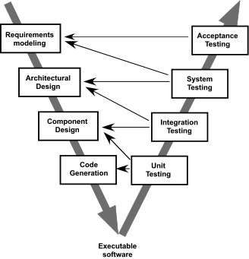
The V-Model
Relationship of assurance actions actions associated
quality to the
with
communication, modeling, and early construction activities.
It provides a way of visualizing how verification and validation actions are applied to earlier engineering work.

Slide 44
Problems
Real projects rarely follow the sequential flow.
Changes can cause confusion as the project team proceeds.
Difficult for the customer to state all requirements explicitly.
A working version of the program(s) will not be available until late in the project time span.

Slide 45
Waterfall model in Practice
DOD-STD-2167A
Defense Systems Software Development, February 29, 1988.
This document established software development that system life cycle.
"uniform requirements for the are applicable throughout the
The standard was that it was biased toward the Waterfall Model.
Basically, due to a new spam reduction policy enacted by Twitter, Buffer had to remove automated retweets from their product within 2 weeks. If late, they risked six million users losing access to Twitter. In this case, they didn’t have time for iteration — they set final requirements and got to work on delivering.
https://en.wikipedia.org/wiki/DOD-STD-2167A

Slide 46
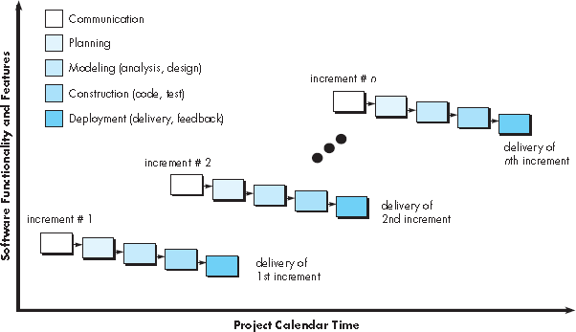
Incremental Process Models
Process model is designed to produce the software in increments

Slide 47
Incremental Process Models
The first increment is often a core product.
For example, word-processing software
basic file management, editing..
spelling and grammar..
advanced page layout capability..

Slide 48

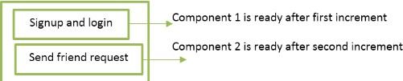

Incremental Process Models Example
Web-based social network

Slide 49
Evolutionary Process Models
Software, like all complex systems, evolves over a
period of time.
Business and product requirements often change.
Tight market deadlines that limit the completion.
Evolutionary models are iterative.
They are characterized in a manner that enables you to develop increasingly more complete versions of the software.
Prototyping
Spiral Model

Slide 50
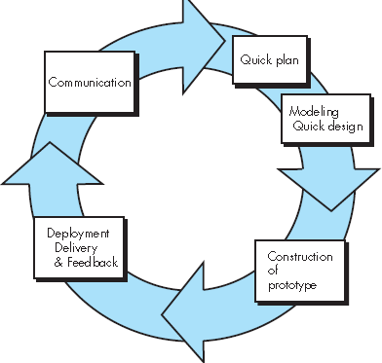
Prototyping
Customer
General Objectives but not detailed requirements.
Developer
Unsure about the efficiency of algorithm.
Human- machine
interaction.

Slide 51
Prototyping
Outline areas where further definition is mandatory
Define the overall
objectives.
Identify requirements
Representation of those aspects of the software that will be visible to end users
e.g. output display formats
The prototype is deployed and Evaluated by stakeholders

Slide 52
Problems in Prototyping
Stakeholders see what appears to be a working version of the software, unaware that the prototype is held together haphazardly.
Implementation compromises in order to get a prototype working quickly.
Inappropriate operating system or programming language may be used.

Slide 53
Spiral Model
Proposed by Barry Boehm.
Spiral model is an evolutionary software process model that couples the iterative nature of prototyping with the controlled and systematic aspects of the waterfall model.
Boehm describes the model in the following manner:
The spiral development model is a risk -driven process model generator that is used to guide multi-stakeholder concurrent engineering of software intensive systems. It has two main distinguishing features. One is a cyclic approach for incrementally growing a system’s degree of definition and implementation while decreasing its degree of risk. The other is a set of anchor point milestones for ensuring stakeholder commitment to feasible and mutually satisfactory system solutions.

Slide 54


Spiral Model
planning estimation scheduling risk analysis
communication
modeling
analysis
design
start
deployment delivery feedback
construction
code
test

Slide 55
Spiral Model
planning estimation scheduling risk analysis
Concept development project
New
product development
project
communication
modeling
analysis
design
start
deployment delivery feedback
Product enhancement
project
construction
code
test

Slide 56
Concurrent Models
none
Allows a software
iterative
team to and
Modeling act ivit y
represent
concurrent elements of any of
the process model.
Under development
represents the state
of a software engineering activity or task
An activity— modeling —may be in any one of the states noted at any given time.
Similarly, other activities, actions, or tasks (e.g., communication or construction ) can be represented in an analogous manner.
Await ing changes
Under review
Under revision
Baselined
Done

Slide 57
Problems
https://www.ics.uci.edu/~emilyo/SimSE
/downloads.html
Provide three examples of software projects that would be amenable to the prototyping model. Be specific.

Slide 58
Specialized Process Models
Specialized process models take on many of the characteristics of one or more of the traditional models.
Component-Based Development
The Formal Methods Model
Aspect-Oriented Software Development

Slide 59
Component-Based Development
The component-based development model incorporates many of the characteristics of the spiral model.
Evolutionary in nature
Iterative approach
Applications from prepackaged software components
Commercial off-the-shelf (COTS) software components.
Provide targeted functionality with well-defined interfaces that enable the component to be integrated into the software.

Slide 60
Component-Based Development
Component-based development model incorporates the following steps.
Available component-based products are researched and
evaluated for the application domain in question.
Component integration issues are considered.
A software architecture is designed to accommodate the
components.
Components are integrated into the architecture.
Comprehensive testing is conducted to ensure proper functionality.

Slide 61
Component-Based Development
Advantages
Software reuse
Reduction in development cycle time
Reduction in project cost

Slide 62
Examples of COTS
Microsoft Office is a COTS product that is a packaged software solution for businesses.
Anti-virus programs
Database managers
Education/training software
SAP
Inventory management
Payroll tax processing

Slide 63
The Formal Methods Model
It encompasses a set of activities that leads to formal mathematical specification of computer software.
A variation on this approach, is called
Cleanroom software engineering.
It enables to specify, develop, and verify a computer-based system by applying a rigorous, mathematical notation.

Slide 64
The Formal Methods Model
Advantages:
Ambiguity, incompleteness, and inconsistency can be discovered and corrected more easily.
Formal methods used during design, serve as a basis for program verification.
Shortfalls:
Time consuming and expensive.
Extensive training is required.
Difficult to use the models as a communication mechanism

Slide 65


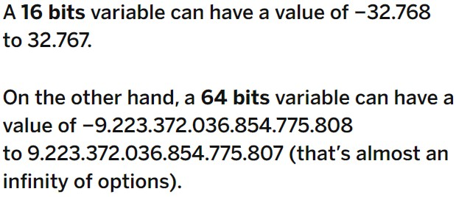
Safety Critical Systems
Formal methods model are widely used
systems.
in safety critical
Nuclear reactors, chemical plants, avionics, medical care, space missions, railway signaling, ...
Gangnam Style Broke Youtube
The maximum value for a 32-bit signed
a 64-bit variable with
decimals was transformed into a 16-bit variable without decimals.
integer is 2, 147, 483, 647 and when a song Gangnam Style came to the views on this hit song by Korean pop star exceeded the maximum value

Slide 66
Aspect-Oriented Software Development
When developing a software,
localized
software characteristics are modeled as components (e.g., object-oriented classes) and then integrated into the whole system.
Concerns:
Security, fault tolerance
Application of business rules
Task synchronization, memory management

Slide 67
Aspect-Oriented Software Development
Aspectual requirements concerns that have an software architecture.
define impact
crosscutting across the
Aspects —“mechanisms beyond subroutines and inheritance for localizing the expression of a crosscutting concern”
Aspect-oriented software development
provides a
process and methodological approach for defining, specifying, designing, and constructing aspects.

Slide 68
The Unified Process
Unified Process is an attempt to draw on the best features and characteristics of traditional software process models.
Streamlined methods for describing the customer’s view of a system (the use case).
A use case is written by the user and serves as a basis for the creation of a more comprehensive analysis model.
UML—a unified modeling language that contains a robust notation for the modeling and development of object- oriented systems.

Slide 69
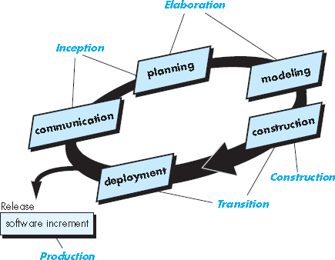
The Unified Process

Slide 70
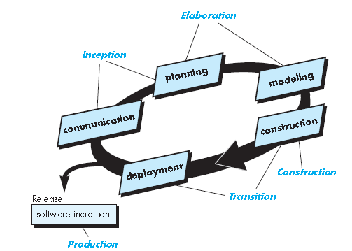
The Unified Process
Inception Phase:
Customer communication and planning activities.
A rough architecture for the system is proposed.
A set of preliminary use cases that describe which features and functions each major class of users desires.
Planning identifies resources, assesses major risks, defines a schedule, and establishes a basis for the phases that are to be applied as the software increment is developed.

Slide 71
The Unified Process
Elaboration phase:
It refines and expands the preliminary use cases.
Expands the architectural representation to include five different views of the software— the use case model, the analysis model, the design model, the implementation model, and the deployment model.

Slide 72
The Unified Process
Construction phase:
Uses the architectural model as input
In this phase, the software components are developed or acquired that will make each use case operational for end users.
Components are implemented, unit tests are designed and executed for each.

Slide 73
The Unified Process
Transition phase:
Delivery and feedback activities.
Software is given to end users for beta testing, and user feedback reports both defects and necessary changes.
Necessary support information
e.g., user manuals, troubleshooting guides, installation
procedures
Production phase:
The ongoing use of the software is monitored, support for the operating environment (infrastructure) is provided, and defect reports and requests for changes are submitted and evaluated.

Slide 74


AGILE DEVELOPMENT

Slide 75
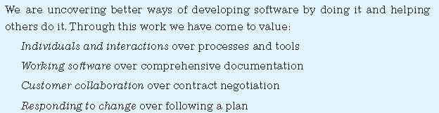
What Is Agility ?
An agile team is a nimble team appropriately respond to changes.
able to
The pervasiveness of change is the primary driver for agility.
Agile Manifesto

Slide 76
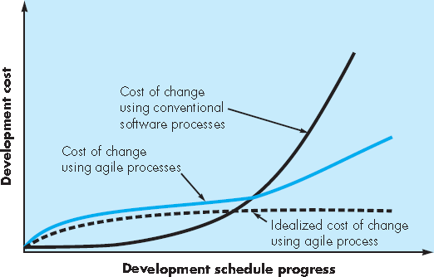
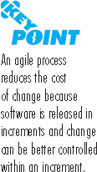
Agility and the Cost of Change
Agile Process

Slide 77
Agile Process
Basic Assumptions of a Software Project
It is difficult to predict in advance which software requirements will persist and which will change.
It is difficult to predict how much design is necessary before construction is used to prove the design.
How do we create a process that is agile and can manage unpredictability ?

Slide 78
Agile Process
Is driven by customer descriptions of what is required (scenarios)
Recognizes that plans are short-lived
Delivers multiple ‘software increments’
Adapts as changes occur

Slide 79
Agility Principles
Our highest priority is to satisfy the customer through early and continuous delivery of valuable software.
Welcome changing requirements, even late in development. Agile processes harness change for the customer's competitive advantage.
Deliver working software frequently, from a couple of weeks to a couple of months, with a preference to the shorter timescale.
Business people and developers must work together daily
throughout the project.
Build projects around motivated individuals. Give them the environment and support they need, and trust them to get the job done.
The most efficient and effective method of conveying information
to and within a development team is face–to–face conversation.

Slide 80
Agility Principles
Working software is the primary measure of progress.
Agile processes promote sustainable development. The sponsors, developers, and users should be able to maintain a constant pace indefinitely.
Continuous attention to technical excellence and good design enhances agility.
Simplicity – the art of maximizing the amount of work not done
– is essential.
The best architectures, requirements, and designs emerge from
self–organizing teams.
At regular intervals, the team reflects on how to become more effective, then tunes and adjusts its behavior accordingly.

Slide 81
The Politics of Agile Development
There is considerable debate (sometimes strident) about the benefits and applicability of agile software development as opposed to more conventional software engineering processes.
Like all software technology arguments, this methodology debate risks degenerating into a religious war. If warfare breaks out, rational thought disappears and beliefs rather than facts guide decision making.
No one is against agility. The real question is: What is the best way to achieve it?
There are no absolute answers to either of these questions. Even within the agile school itself, there are many proposed process models, each with a subtly different approach to the agility problem.

Slide 82
Human Factors
The process molds to the needs of the people and team, not the other way around
key traits must exist among the people on an agile team and the team itself:
Competence.
Common focus.
Collaboration.
Decision-making ability.
Fuzzy problem-solving ability.
Mutual trust and respect.
Self-organization.

Slide 83
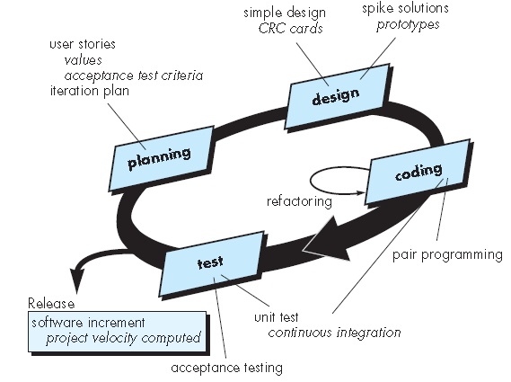
Extreme Programming
Extreme Programming (XP), the most widely used approach to agile software development.
XP Process

Slide 84
Extreme Programming (XP)
XP Design- Follows the KIS principle
Encourage the use of CRC (class-responsibility-collaborator) cards
For difficult design problems, suggests the creation of a spike solution (a design prototype)
A spike solution is a very simple program to explore potential solutions.
Encourages “refactoring”—an iterative refinement of the internal program design
XP Coding
Recommends the construction of a unit test for a store before coding commences
Test oriented implementation
Encourages “pair programming”
XP Testing- All unit tests are executed daily
“Acceptance tests” are defined by the customer and executed to assess customer visible functionality

Slide 85
XP Process
XP Planning
Begins with the creation of “user stories”
Agile team assesses each story and assigns a cost
Stories are grouped to for a deliverable increment
A commitment is made on delivery date
After the first increment “project velocity” is used to help define subsequent delivery dates for other increments

Slide 86
User story Example
User Story - Registration Screen - Username and Password
creation
User Story:
As a customer, I want to create login credentials so I can securely access my self-service online account
Acceptance Criteria:
Input data fields to enter - 1) Username 2) Password 3) Re-enter Password 4) Security question 5) Security answer
Username data field specifications - TBD for specifications
Password data field specifications - At least 7 characters, 1 number, 1 uppercase letter, 1 lowercase letter, one special character
Security questions drop-down - TBD for content
Security Answer data field specifications - at least 4 characters

Slide 87
XP Process
XP Design
Encourage the use of CRC (Class- responsibility-collaboration) cards
For difficult design problems, suggests the creation of “spike solutions”—a design prototype
Encourages “refactoring”—an iterative refinement of the internal program design

Slide 88
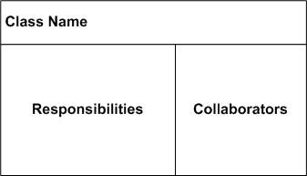
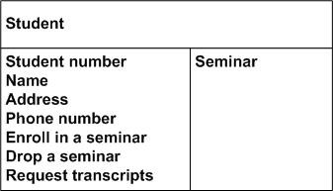
CRC Card Example

Slide 89
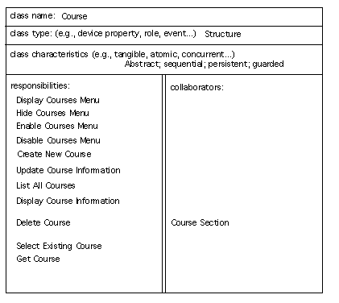
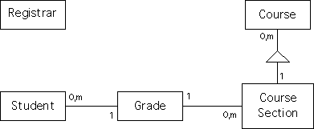
CRC Card Example
Student Information System

Slide 90


XP Process
XP Coding
Recommends the construction of a unit test for a store before coding commences
Encourages “pair programming”

Slide 91
XP Process
XP Testing
All unit tests are executed daily
“Acceptance tests” are defined by the customer and executed to assess customer visible functionality

Slide 92
User story
Write an XP user story that describes the “favorite places” or “favorites” feature available on most Web browsers.
Create a CRC card for the same.

Slide 93


Other Agile Process Models

Slide 94
Scrum
Scrum principles are consistent with the agile manifesto
It is used to guide development activities within a process that incorporates the following framework activities: requirements, analysis, design, evolution, and delivery.
Work tasks occur within a process pattern called a sprint.

Slide 95
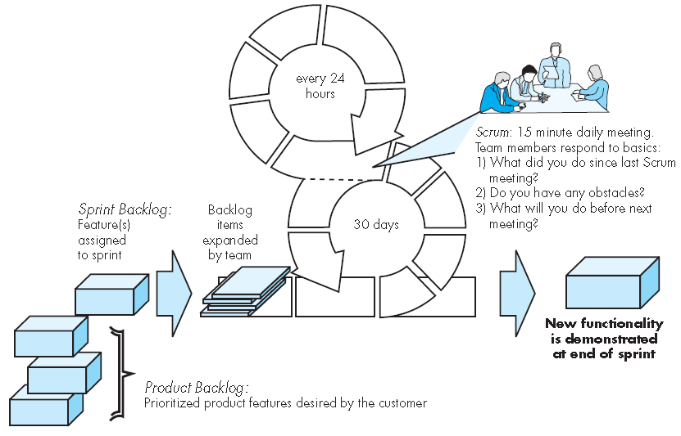
Scrum Process

Slide 96
Scrum Process
Backlog —a prioritized list of project requirements or features that provide business value for the customer.
The product | manager | assesses | the
backlog and | updates | priorities | as
required.

Slide 97
Scrum Process
Sprints —consist of work units that are required to achieve a requirement defined in the backlog that must be fit into a predefined time-box 10 (typically 30 days).
Changes (e.g., backlog work items) are not introduced during the sprint.

Slide 98
Scrum Process
Scrum meetings —are short (typically 15-minute)
meetings held daily by the
Scrum team. Three key questions are asked and answered by all team members
What did you do since the last team meeting?
What obstacles are you encountering?
What do you plan to accomplish by the next team meeting?
A team leader, called a Scrum master, leads the meeting and assesses the responses from each person.

Slide 99
Scrum Process
Demos —deliver the software increment to the customer so that functionality
that has been implemented
can be by the
demonstrated and evaluated customer.

Slide 100
Dynamic Systems Development Method (DSDM)
It “provides a framework for building and maintaining systems which meet tight time constraints through the use of incremental prototyping in a controlled project environment”.
DSDM is an iterative software process in which each
iteration follows the 80 percent rule.
That is, only enough work is required for each increment to facilitate movement to the next increment. The remaining detail can be completed later.

Slide 101
Dynamic Systems Development Method (DSDM)
DSDM life cycle
Feasibility study that establishes basic business requirements and constraints and is followed by a business study that identifies functional and information requirements.
Functional model iteration— produces a set of incremental prototypes that demonstrate functionality for the customer.

Slide 102
Dynamic Systems Development Method (DSDM)
DSDM life cycle
Design and build iteration— revisits prototypes built during the functional model iteration to ensure that each has been engineered in a manner that will enable it to provide operational business value for end users.
Implementation— places the latest software increment (an “operationalized” prototype) into the operational environment.

Slide 103
Agile Modeling
Business-critical systems
(1) all constituencies can better understand what needs to be accomplished.
(2) the problem can be partitioned effectively among the people who must solve it.
(3) quality can be assessed as the system is being engineered and built.

Slide 104
Agile Modeling principles
Model with a purpose
A developer who uses AM should have a specific goal
(e.g., to communicate information to the customer or to help better understand some aspect of the software) in mind before creating the model.
Use multiple models
AM suggests that to provide needed insight, each model should present a different aspect of the system and only those models that provide value to their intended audience should be used.

Slide 105
Agile Modeling principles
Travel light.
As software engineering work proceeds, keep only those models that will provide long-term value and jettison the rest.
Content is more important than representation.
Modeling should impart information to its intended audience.
Know the models and the tools you use to create them.
Understand the strengths and weaknesses of each model and the tools that are used to create it.
Adapt locally.
The modeling approach should be adapted to the needs of the agile team.

Slide 106
SPI (Software Process Improvement)
It implies that elements of an effective software process can be defined in an effective manner.
An existing organizational approach to software development can be assessed against those elements.
A meaningful strategy for improvement can be defined.

Slide 107
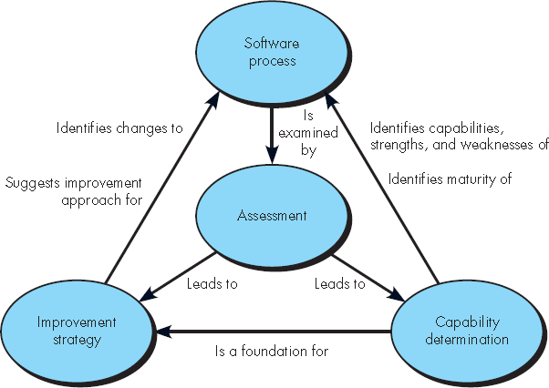
SPI (Software Process Improvement)
An SPI framework defines
(1) a set of characteristics that must be present if an effective software process is to be achieved,
(2) a method for assessing whether those characteristics are present,
(3) a mechanism for summarizing the
results of any assessment
(4) a strategy for assisting a software organization in implementing those process characteristics that have been found to be weak or missing.

Slide 108
The SPI Process
Assessment and Gap Analysis
It examines a wide range of actions and tasks that will lead to a high-quality process.
Is the objective of the activity clearly defined?
Are work products required as input and produced as output identified and described?
Are the work tasks to be performed clearly described?
Are the people who must perform the activity identified by role?
Have entry and exit criteria been established?
Have metrics for the activity been established?
Are tools available to support the activity?
Is there an explicit training program that addresses the activity?
Is the activity performed uniformly for all projects?

Slide 109
The SPI Process
Education and Training
It follows that a key element of any SPI strategy is education and training for practitioners, technical managers, and more senior managers who have direct contact with the software organization.
Three types of education and training should be conducted:
generic software engineering
concepts and methods,
specific technology and tools, and communication and
quality-oriented topics.

Slide 110
The SPI Process
Selection and Justification
Process characteristics and specific software engineering methods and tools are chosen to populate the software process.
Choose the process model
Decide the set of framework activities
Major work products that will be produced

Slide 111
The SPI Process
Installation/Migration
Installation is the first point at which a software organization feels the effects of changes implemented as a consequence of the SPI road map.
An incremental migration from one process (that doesn’t work as well as desired) to another process is a more effective strategy.

Slide 112
The SPI Process
Evaluation
Assesses the degree to which changes have been instantiated and adopted, the degree to which such changes result in better software quality.
Risk Management for SPI
Experience with quality programs, level of success
Patience with change; ability to spend time socializing
Tools orientation—expectation that tools can solve the problems

Slide 113
Capability Maturity Model(CMMI)
A comprehensive process meta-model that is predicated on a set of system and software engineering capabilities that should be present as organizations reach different levels of process capability and maturity.
Capability levels:
Level 0: Incomplete
Level 1: Performed
Level 2: Managed
Level 3: Defined
Level 4: Quantitatively managed
Level 5: Optimized

Slide 114
Capability Maturity Model(CMMI)
Level 0: Incomplete —
The process area (e.g., requirements management) is either not performed or does not achieve all goals and objectives defined.
Level 1: Performed —
All of the specific goals of the process area (as defined by the CMMI) have been satisfied.
Level 2: Managed —
All capability level 1 criteria have been satisfied. In addition, all work associated with the process area conforms to an organizationally defined policy.

Slide 115
Capability Maturity Model(CMMI)
Level 3: Defined —
All capability level 2 criteria have been achieved. In addition, the process is “tailored from the organization’s set of standard processes according to the organization’s tailoring guidelines, and contributes work products.
Level 4: Quantitatively managed
All capability level 3 criteria have been achieved.
Level 5: Optimized —
All capability level 4 criteria have been achieved.
In addition, the process area is adapted and optimized using quantitative (statistical)
means to meet changing customer needs

Slide 116
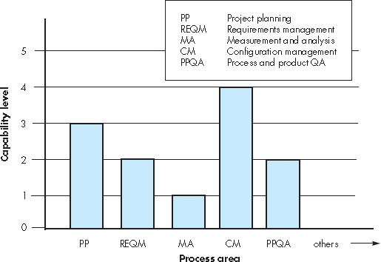
Capability Maturity Model(CMMI)

Slide 117
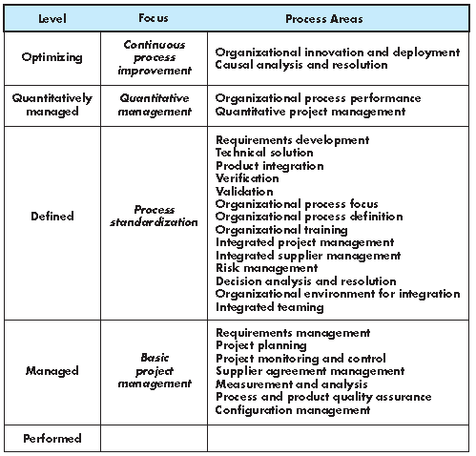
CMMI and Process Areas

Slide 118
Review Questions
What is the simplest model of software development paradigm?
a.Spiral model
b.Big Bang model
c.V-model
d.Waterfall model

Slide 119
Review Questions
Programs, documents, and data produced are .
Product
Work product
Tools
Methods

Slide 120
Review Questions
Software is developed or engineered (by following systematic, disciplined and quantifiable approach), it is not manufactured.
True
False

Slide 121
Review Questions
Spiral model is suitable for student projects.
True
False

Slide 122
Review Questions
Prototyping model and follows generalize
spiral
model
approach of
Waterfall Model (Linear sequential model)
Incremental Model

Slide 123
Review Questions
model
follows
"quick
■
design" approach. a.Linear Sequential Model b.Prototype Model
c. Spiral Model
d. Incremental model

Slide 124
Questions
You work for a very small
software
organization—only 11 people are involved in developing software. Is SPI for you? Explain your answer.

